Slide 1
Louisiana Teen Readers’ Choice Award
Grades 9-12

Slide 2
Notes:
https://www.youtube.com/watch?feature=player_embedded&v=RG5BQVz0cLQ

Slide 3
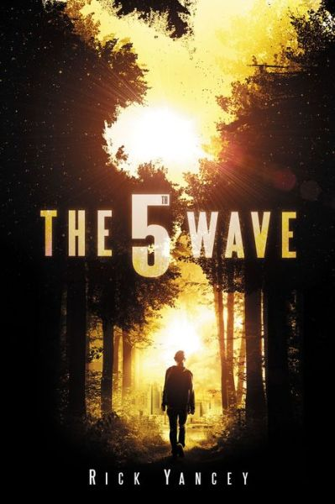
The 5th Wave Rick Yancey
Notes:
Booktalk 1
Earth had the wrong idea about aliens all along. In reality, they show no trace of similarity to the friendly green creatures that everyone imagines from movies and comics so no one saw them coming, and no one expected a hostile takeover without warning. Humanity didn’t have a chance to prepare for the attack that came in four well-planned parts, and now the aliens have won. All that remains to come is the fifth wave, the final stage of the invasion that will wipe out the few remaining humans.
Among the survivors are Cassie and Zombie. Cassie is barely surviving after losing both of her parents in the first stages of the attack, and she searches desperately for her little brother while trying to evade the assassins who hunt humans as part of the fourth wave. Zombie, a former athlete, is now training as part of the last opposition to the aliens. Though the death of the human race seems like the only possible outcome of the dystopian situation, these teens find reasons to keep resisting.
Booktalk 2
When the mothership first appeared in the sky, there was a sense of excitement and anticipation. People hoped to make contact and to learn about the advanced civilization that had come to visit Earth like an exotic vacation spot. But Earth had the wrong idea all along.
The Others, as they have come to be called, show no trace of familiarity to the friendly green creatures from cartoons or even the evil-but-beatable villains from science fiction horror movies; Earth never had a chance against them, and their interest in the planet involves neither a short timeframe nor the existence of humans. Their attack came in four parts, and now the aliens have all but won. All that remains to come is the fifth wave, the final stage of the invasion that will wipe out the few humans who have been lucky, or unlucky, enough to survive this long.
Cassie is one of those few, and she has lost everything. She is barely surviving after losing both of her parents, her friends, and her home in the first stages of the attack. She clings to her M16 and a teddy bear, always wondering if she might be the last human alive, and the only purpose she has left is fulfilling her promise to find her little brother.
Zombie too has lost everything – family, friends, and all sense of normalcy in the world – but, unlike Cassie, never has to worry if he’s the only one left. He has ended up in one of the most highly-populated refugee areas, and even though he has been left in a zombie-like state, physically and mentally, by the disease that killed so many in the third wave, he is training as part of the last opposition to the aliens.
The Silencer is not a survivor; he is one of the Others, a sleeper agent awakened to kill humans in the fourth wave. He knows his task, and has all of the skills necessary to execute it. Still, he struggles with the memory of what it’s like to be human, questioning his purpose, especially as he hunts Cassie.
Though the death of the human race seems like the only possible outcome of this dystopian story, these teens find reasons to keep resisting against all of the odds.

Slide 4
Notes:
https://www.youtube.com/watch?feature=player_embedded&v=4Gafz1-oucU

Slide 5
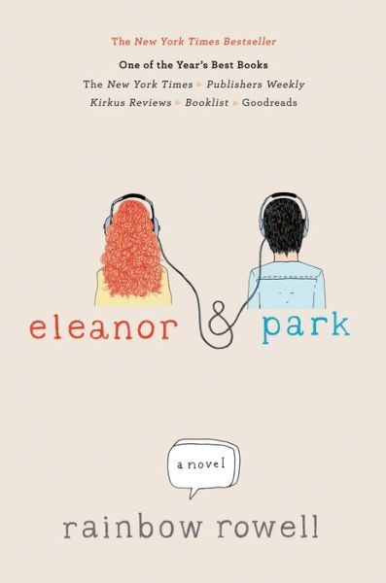
Eleanor & Park Rainbow Rowell
Notes:
Booktalk 1
When Park moves towards the bus window to make room for the new girl Eleanor, it’s not a gesture of friendship, just one of decency; no one else will let her sit because of her red hair, imperfect figure, and lack of fashion sense. Not that Park is one to talk – he’s a misfit as well and only wants to avoid attention. In a way, they’re perfect for one another, and the bus ride they share each day leads to a relationship that is stronger than either of them could have imagined.
Their 1980s high school romance is full of comic books, mixtapes, and hand-holding that allows them to go beyond the differences of their home lives and school caste. They face the struggles of living up to parental expectations and not fitting in with peers that are familiar to many teens as well as the serious consequences of abuse. Though quirky, their story is anything but unrealistic.
Booktalk 2
Park is more than happy to keep his head down. If he plays his music loud enough and doesn’t look up from his comic books, it’s as if the morons around him at school aren’t even there. At home, he can humor his martial-arts-obsessed father by excelling in taekwondo lessons, and having his own car soon will make life that much easier. He has a perfectly comfortable place in the teenage ecosystem, and that’s why he knows it’s a huge mistake to risk upsetting the balance by being the only person decent enough to let the weird new girl sit next to him on the bus.
Eleanor doesn’t expect to fit in. Being ostracized and bullied at school is par for the course; what else should she expect with her untamable red curls, plus-sized body, and unfashionable clothes? She can’t expect perfect grades either since she stares out the window through class, but school is still a break from home. Home means sharing a room with her four younger siblings, trying not to draw the attention of her abusive step-father, and struggling to find a sense of normalcy in the poverty that leaves her without access to a washing machine, toothbrush, or food fancier than beans or grilled cheese. Sitting next to that stupid Asian kid on the bus is just a small awkward part of her day.
In a way, Eleanor and Park are perfect for one another, despite the extreme hesitation on both sides, and the bus ride they share each day leads to a relationship that is stronger than either of them could have imagined. They are the epitome of head-over-heels, clever, heartbreaking young love. Their 1980s high school romance is full of comic books, mixtapes, and hand-holding that allows them to go beyond the differences of their home lives and school caste. They face struggles that are familiar to many teens and expose others that some may never have considered. Though quirky, their story is anything but unrealistic.

Slide 6
Notes:
https://www.youtube.com/watch?feature=player_embedded&v=wVwro9_3mfA

Slide 7
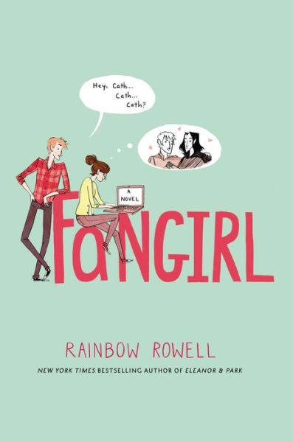
Fangirl Rainbow Rowell
Notes:
Booktalk 1
Fandom has always been Cath’s way of coping with change and tragedy in her life; she writes fanfiction for the popular Simon Snow book series and loves the community that comes with it. Now, away from home for the first time at college, the thought of branching out and embracing new experiences makes her want to retreat into the world of her fandom completely. She worries about her father living alone, and, to add even more to the overwhelming sense of change and loneliness in her life, her twin sister Wren decides to live in another dorm and add some distance to their relationship in hopes of being seen as more of an individual person than part of a twin pair. Cath is forced outside of her box by professors and a new roommate and is initially unsure of the constant presence of her roommate’s former boyfriend. Throughout her freshman year, she struggles to overcome her insecurity while trying not to lose her identity as a fangirl.
Booktalk 2
Fandom has always been Cath’s way of coping with change and tragedy in her life; she writes fanfiction for the popular Simon Snow book series and loves the community that comes with it. In fact, as Magicath she has become one of the most popular authors on FanFixx.net, receiving thousands of hits a day on her stories and so many comments that she couldn’t reply to them all if she tried.
Now, away from home for the first time at college, the thought of branching out and embracing new experiences makes her want to retreat into the world of Simon Snow completely. Even finding the dining hall seems like too much. What if she doesn’t know where the line starts? Where would she sit? …no, she’ll just have to live on the box of protein bars she has stashed under her bed and dream of the taco trucks in her neighborhood back home.
She worries that her father, living alone, will work too hard and give in to his sometimes unhealthily-eccentric qualities and, to add even more to the overwhelming sense of change and loneliness in her life, her twin sister Wren with whom she has always been close has decided to live in another dorm and add some distance to their relationship in hopes of being seen as more of an individual person than part of a twin pair. The days of having a built-in best friend and of writing together as Magicath and Wrenegade are over, and instead Cath is stuck with an intimidating older roommate, Reagan, and Reagan’s ever-present boyfriend (or former boyfriend, Cath can’t be sure) who is always absurdly friendly.
Though Cath hopes to find some comfort in her fiction writing class – after all, writing is one thing she knows with absolute certainty she can do well – her favorite professor is forced to give her a failing grade on an assignment, calling her fanfiction plagiarism, and the reprimand seems to crush the one element of college that Cath actually enjoyed.
Though everything seems to be against her, Cath must struggle to overcome her insecurities and discover whether that’s possible without losing her identity as a fangirl.

Slide 8
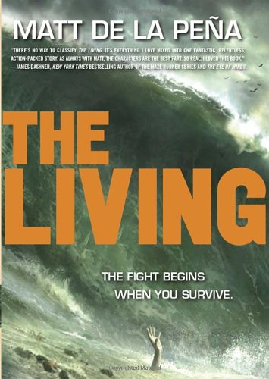
The Living Matt de la Peña
Notes:
Booktalk 1
Disease outbreak. Natural disasters. Conspiracy. Floating on a life raft with a stuck-up girl who is pretty much the worst candidate for survival companion in the case of end-of-the-world level societal upheaval.
Shy Espinoza can’t help but wonder how this all became his reality when, just a few days ago, he was happily working what should have been an easy and enjoyable summer job on a cruise ship. Maybe the cryptic message he received from an agitated passenger on the ship who then committed suicide should have been a warning, but a warning of what exactly?
This story seems to begin as realism but quickly evolves into one of adventure and survival before then developing its elements of mystery into a full-scale conspiracy thriller. On top of it all, Shy as a main character unassumingly weaves the culture of Southern California and the Mexican border into the action. By the end of the book, Shy’s world is a completely different place than it started, and there are fewer answers than questions. Readers will eagerly search for the sequel.
Booktalk 2
Disease outbreak. Earthquake. Tsunami. Conspiracy. Floating on a life raft with a stuck-up girl who is pretty much the worst ever candidate for survival companion in the case of end-of-the-world level societal upheaval.
Shy Espinoza can’t help but wonder how this all became his reality when, just a few days ago, he was happily working what should have been an easy and enjoyable summer job. It was ideal, really. He was always the strong one in his family, especially after the recent death of his grandmother, and would have gotten a summer job to help support his mom, sister, and nephew no matter what, but the opportunity to work on a cruise ship was the obvious choice over a local restaurant or tire shop. He got to make friends with people from around the world and, one in particular, from his own home neighborhood, Carmen, who was amazing in every way… except for the fact that she was engaged. Still, he couldn’t make many complaints about the job.
Of course, that was all before the previously mentioned cluster of disasters turned his world upside-down, leaving him to worry, not about getting tips from wealthy passengers with entitled attitudes, but about keeping them (and himself) from drowning, being eaten by sharks, or dying from dehydration when all rescue crews are occupied by the devastation on land. Not to mention the stress of not knowing the effects for his family back home. He just can’t ignore the growing suspicion that the cryptic message he received from an agitated passenger on the ship who then committed suicide should have been a warning, but a warning of what exactly?
This story seems to begin as realism but quickly evolves into one of adventure and survival before then developing its elements of mystery into a full-scale conspiracy thriller. On top of it all, Shy as a main character unassumingly weaves the culture of Southern California and the Mexican border into the action. By the end of the book, Shy’s world is a completely different place than it started, and there are fewer answers than questions. The cliff-hanger ending will lead readers to eagerly search for the sequel, The Hunted.

Slide 9
Notes:
https://www.youtube.com/watch?feature=player_embedded&v=FCnn3Bniz94

Slide 10
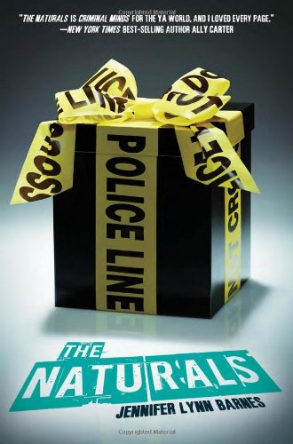
The Naturals Jennifer Lynn Barnes
Notes:
Booktalk 1
Cassie’s talent for profiling people is one she learned from her mother, and for the last five years, ever since her mother’s mysterious murder, she has had extra motivation to hone her skill. It seems that her effort has finally paid off when she, along with four other gifted teenagers, is recruited by the FBI to become part of an elite team. For their own protection, the team is only assigned to cold cases, and Cassie constantly looks for connections to her mother’s murder among them. What she doesn’t expect, however, is to become the target of a serial killer, a potential copycat of her mother’s killer, who is part of a case that is still very much active. Though no one on the team is accustomed to working with people who can profile them in the way they profile others, will they be able to work together to solve the case before something happens to Cassie?
Booktalk 2
When Cassie’s mother was murdered five years ago, her life was irrevocably changed. Neither the killer nor her mother’s body was ever found, and with her father constantly travelling for his military job, she has been left to grow up with the rest of his big, Italian family where she has been comfortable but has never really felt a sense of belonging.
While she still has nightmares about finding the scene of the crime, her mother’s murder did give her extra motivation to practice her skill for profiling people, an ability she inherited from her mother in the first place; in fact, she has practiced to near-perfection. Now, five years later, it seems that her effort has finally paid off when someone important takes notice, bringing on Cassie’s second life-changing event.
Starting with a mysterious business card delivered to her by an incognito diner during one of her shifts as a waitress at her summer job, Cassie is whisked into an FBI recruitment program for gifted teens: two profilers, an emotions expert, a human lie detector, and a genius with probabilities and numbers. Collectively called Naturals, the teens work with FBI agents to hone their skills and solve cases, a task that Cassie is warned can be very disturbing.
For their protection, the Naturals work only with cold cases, and Cassie constantly looks for connections to her mother’s murder among them. What she doesn’t expect, however, is to become the target of a serial killer herself, a potential copycat of her mother’s killer, who is part of a case that is still very much active. Though no one on the team is accustomed to working with people who can profile them in the same way they profile others, will they be able to get along with one another and work together to solve the case before something happens to Cassie?

Slide 11
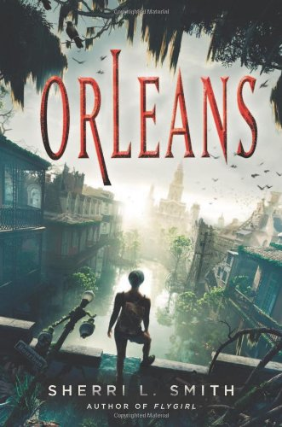
Orleans Sherri Smith
Notes:
Booktalk 1
Long ago, the Gulf Coast was destroyed by brutal hurricanes that increased in intensity every year, preventing any real recovery from taking place. Then, as a result, came the outbreak of the disease, the Delta Fever, that forced the inhabitants of the area to band together by blood type, a feature that quickly became more important than any other in an environment of unchecked infection. Finally, when the situation became so dire that the government could see no solution, the Orleans of today was quarantined and walled off, separating what was left of the Gulf coast from the rest of the world and making any return to normalcy impossible. But that was long ago, and Orleans had been off-limits for years before Daniel, a curious scientist, decided to venture into the ruins to discover the reality of the world beyond the wall and met Fen, a teenager from the O-Positive tribe who was desperate to escape to the outside in time to save a newborn baby from the disease. It is their story that readers will find in Orleans.
Booktalk 2
Long ago, the Gulf Coast was destroyed by brutal hurricanes that increased in intensity every year, preventing any real recovery from taking place. Then, as a result, came the outbreak of the disease, the Delta Fever, that forced the inhabitants of the area to band together by blood type, a feature that quickly became more important than any other in an environment of unchecked infection. Finally, when the situation became so dire that the government could see no solution, the Orleans of today was quarantined and walled off, separating what was left of the Gulf coast from the rest of the world and making any return to normalcy impossible.
But that was long ago, and Orleans has been off-limits for years. Now disease in the area is kept to a minimum by a strict separation of tribes, but the blood trade, desperation stemming from limited resources, and a lack of enforcing power often make this more an ideal than a reality. Some will do anything for a blood transfusion, and this makes life dangerous for those like O-Positive Fen de la Guerre and her tribe leader Lydia. When the ABs attack and Lydia dies in childbirth, Fen is left with a baby girl, one she is determined to get to the outside world in time to save her from the Fever.
While those from the outside world generally have no reason or desire to cross the heavily-guarded Wall, especially since they imagine that humanity must be nearly extinct in the Delta, some do it out of greed. In such an isolated place, trade is valuable, and there are those willing to risk disease in order to make a profit, even at the risk of infecting others upon their return to the Outer States. Far less common are those like Daniel, a scientist from the Outer States who lost his younger brother to an outbreak of Delta Fever and has dedicated his life to curing it. He crosses the Wall and ventures into the ruins with curiosity and good intentions only to meet Fen and discover the reality of the world beyond the Wall.
Orleans is the story of Fen, Daniel, and their quest to save a baby and an entire civilization from disease.

Slide 12
Notes:
https://www.youtube.com/watch?feature=player_embedded&v=JMvLPVUMFZQ

Slide 13
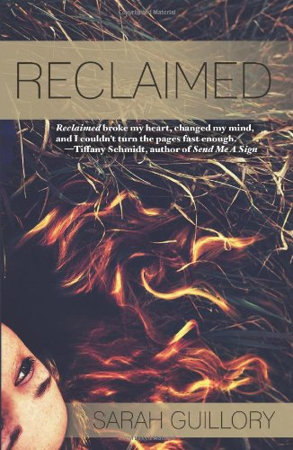
Reclaimed Sarah Guillory
Notes:
Booktalk 1
Twins Luke and Ian McAlister are new to the small town of Solitude while Jenna Oliver, on the other hand, has lived there since birth and is doing everything she can to escape it. In addition to the usual high school stresses, the three have their own unique problems to deal with: memory loss, destructive anger, and frustration with an alcoholic mother. None of them expect to find time for new relationships among the upheaval in their lives, but the guilt and the dissatisfaction with life’s apparent lack of options that they all experience draws them together in unexpectedly forceful ways. Will their attraction to Jenna help to mend the twin’s relationship or further fracture it? Will falling for, not one, but both of the twins, against her better judgment, ruin Jenna’s chances for getting out of the small town or help her to see it in a new light? In a story full of family struggles and secrets with more than a little mystery, the entanglement of their stories forces the truth to come out in a surprising final twist.
Booktalk 2
Twins Luke and Ian McAlister are new to the small town of Solitude while Jenna Oliver, on the other hand, has lived there since birth and is doing everything she can to escape it.
Jenna has always wanted to escape, not because the town is too small to offer her options but because it’s too small for anyone to forget her family’s past; everyone knows that her mother got pregnant in high school, and the reputation follows her. Believing that the only solution is a fresh start in a place where no one knows her, Jenna focuses on school and cross country, viewing relationships as a distraction that could interfere with her careful plans. Still, when the McAlister twins move into Jenna’s grandfather’s house after his death leaves her feeling untethered, it seems only appropriate that they should become a part of her life.
The twins may be identical in appearance, but their personalities have recently diverged. When an unnamed incident has lasting effects for Ian, the family is uprooted trying to find a doctor to treat him. He feels responsible for disrupting their lives and struggles with guilt, drawing into himself and losing hope that he will ever be who he was before. His brother Luke, however, struggles with his own guilt, lashing out in contrast to his brother’s reaction.
In addition to the usual high school stresses, the three have their unique problems to deal with: memory loss, destructive anger, and frustration with an alcoholic mother. None of them expect to find time for new relationships among the upheaval in their lives, but the dissatisfaction with life’s apparent lack of options that they all experience draws them together in unexpectedly forceful ways. Will the twins’ attraction to Jenna help to mend their relationship or further fracture it? Will falling for, not one, but both of the twins, against her better judgment, ruin Jenna’s chances for getting out of the small town or help her to see it in a new light? In a story full of family struggles and secrets with more than a little mystery, the entanglement of their stories forces the truth to come out in a surprising final twist.

Slide 14
Notes:
https://www.youtube.com/watch?feature=player_embedded&v=6sC9NtpXLH4

Slide 15
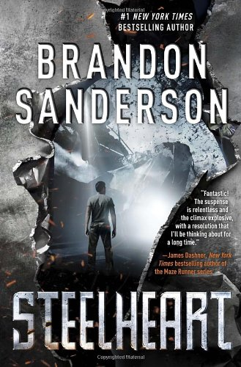
Steelheart Brandon Sanderson
Notes:
Booktalk 1
In a world in which super-powered evil villains really exist, the concept of superheroes who have the ability and duty to swoop in and save the day becomes even more important… unfortunately, that’s all they are: ideas, not reality. The closest thing the world has to superheroes is a group of talented civilians called the Reckoners. The Reckoners are committed to ridding the world of Epics, the super villains who appeared inexplicably and turned society into the dystopia that it is today, and so of course David wants to be one of them. David has spent a decade accumulating a wealth of knowledge on the abilities and weaknesses of all the Epics, especially one called Steelheart, the tyrant of Newcago who killed his father. If he can only gain their attention and trust, David is sure he can convince the Reckoners to focus their efforts on destroying Steelheart to help him take revenge and to restore some sense of the world’s lost normalcy.
Booktalk 2
Twelve years ago, Calamity appeared in the sky. No one knew what it was (and they still don’t, exactly), but it’s almost certainly linked to the superpowers that ordinary citizens gained shortly after. Those who received these inexplicable powers became known as Epics, awing the public with varying levels of ability; minor Epics gained one or more small talents (like never running out of bullets when firing a gun) and High Epics like Steelheart became nearly invincible. The world was forever changed by the seemingly random evolution of a class of human no one thought possible before. Unfortunately, with the powers came a distinct change in personality, a desire for more and more power, to rule. Thus, “Epic” is just another word for “supervillain.”
Ten years ago, before the world gave up hope that some sort of superhero or would save it, Steelheart, a High Epic who possesses super-strength, the ability to turn any material into steel, and cannot be injured (much less killed) came to what was then Chicago. During his takeover of the city, he was injured – just barely scratched – and in a rage he killed all who might have seen his weakness, including David’s father. David, only eight at the time, survived as the sole witness.
In the dystopia that is the world today, especially in Steelheart’s empire of Newcago, the closest thing the world has to superheroes is a group of talented civilians called the Reckoners. The Reckoners, a secretive group comprised of the only people who dare attempt the job, are committed to ridding the world of Epics, and so of course David wants to be one of them. As the only living person to have ever seen Steelheart bleed, he has unique and valuable information to offer them, and after spending a decade observing the Epics, he knows he needs help to defeat them. If he can only gain the attention and trust of the Reckoners, can he convince them to focus their efforts on destroying Steelheart?

Slide 16
Notes:
https://www.youtube.com/watch?feature=player_embedded&v=f7aelYPyqRM

Slide 17
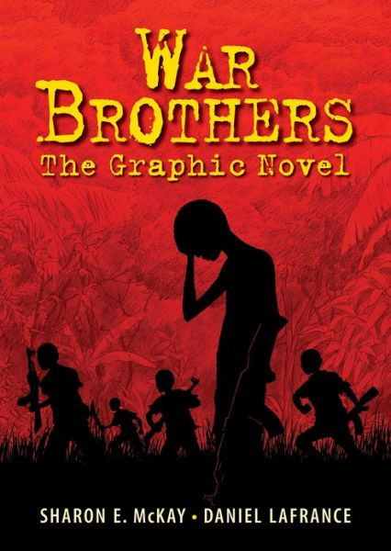
War Brothers Sharon McKay Illustrated by Daniel Lafrance
Notes:
Booktalk 1
Though the beginning of a new school year puts butterflies into the stomachs of most young students, no child should have to experience the same fears that Jacob describes in this graphic novel. It is not new teachers, more difficult homework assignments, or peers that cause his anxiety, and not even his wealthy boarding school with its new security team hired by his father are enough to protect him and his classmates.
After he is abducted from his Ugandan boarding school and forced to become a child soldier in the Lord’s Resistance Army, Jacob’s only comfort and the hope that helps him survive the fatigue, abuse, and terror is the thought that recording his experiences will help others in his situation. He trusts that, if he can only share his story and bring attention to the horror and violence that he witnesses and is forced to commit, the world will send help to stop those who use children to carry out their crimes.
Booktalk 2
Ugandan boys Jacob and his friend Tony look forward to the new school year. They spend the last days of summer playing soccer and imagining the adventures their other friends have had while away from their Christian boarding school for boys. Almost before the bus ride to campus is over, they begin marveling over the stories of a friend who has visited the strange and glamorous city of New York, and they happily take a new student, a younger boy who will be in their classes because he has excelled in academics, under their wings. The extra guards they see at the school – present at the insistence of Jacob’s politically prominent father – assure them that they are safe from the madman Joseph Kony and his Lord’s Resistance Army, the LRA.
It seems like the school year will be full of learning and good times with friends until that night, when the LRA attacks the school without challenge and violently abducts Jacob and his classmates. They are forced to become slaves and child soldiers in the army as they witness and commit horrible acts against convoys of vehicles, entire villages, and other abducted children, all supposedly in the name of a religion they do not recognize. They suffer starvation, exhaustion, and violence and are ultimately kept alive only because they belong to influential families, as bargaining chips to be exchanged for weapons.
When it becomes clear that they cannot wait for rescue any longer, Jacob and a handful of others take matters into their own hands and plan an escape, despite having seen the punishments for those who are caught. The experience changes all of them, and they cannot simply resume their lives afterwards. Jacob makes it his mission to share his story, trusting that, if he can only bring attention to the cruelty of the LRA, the world will send help to stop those who use children to carry out their crimes. War Brothers is his story.

Slide 18
Notes:
https://www.youtube.com/watch?feature=player_embedded&v=ux35quSH4lk

Slide 19
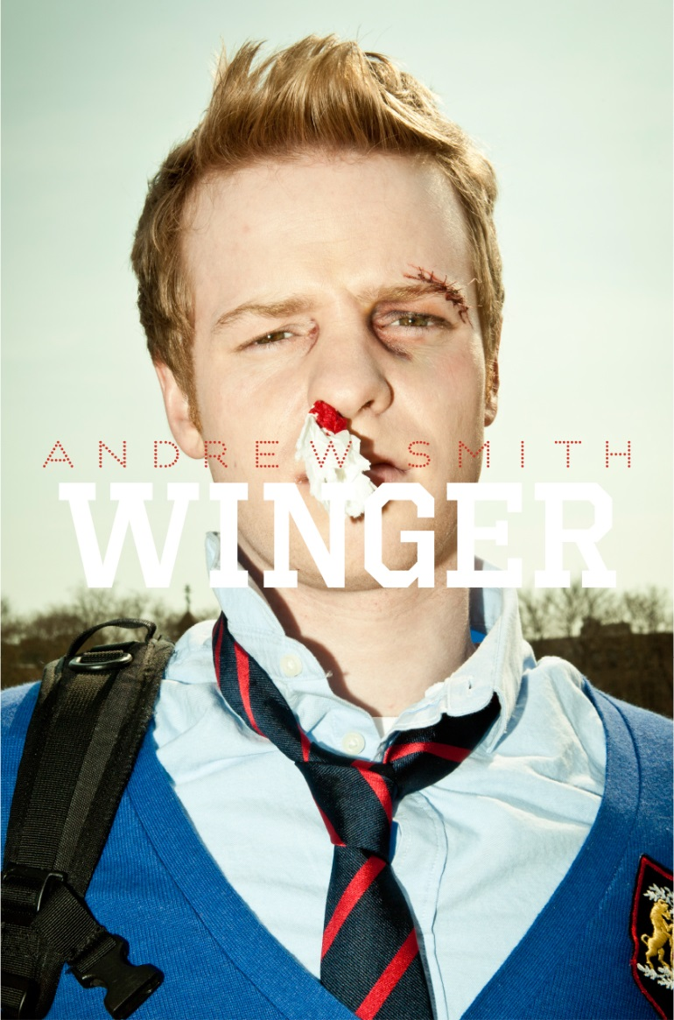
Winger Andrew Smith Illustrated by Sam Bosma
Notes:
Booktalk 1
Adjusting to life at a boarding school for teenagers from wealthy families, especially one that welcomes attention-starved troublemakers, can be difficult for any kid, but Ryan Dean West has the added obstacle of being two years younger than most of his classmates. Having the book smarts to skip grades doesn’t guarantee an equivalent level of maturity or decision-making skills, and this allows Ryan Dean to settle easily into the lewdness and the effortless mix of hostility and camaraderie among his older peers. At the same time, he shows a surprising wisdom in certain matters, and he finds more than a little humor in his situation even as he struggles to redefine himself, wildly chases the attentions of an older girl, and faces the disturbing hate and violence behind prejudice. His narration of his own bildungsroman is clever and engaging, and even through occasional disapproval or distaste, readers cannot help but become invested in his story.
Booktalk 2
The odds seem to be stacked against Ryan Dean West. Not only is he a fourteen-year-old junior in high school, two years younger than his peers thanks to his academic talents, but he has also been placed into Opportunity Hall this year, better known as O-Hall, the dorm designated for trouble-makers at his elite boarding school: cell-like rooms, no locks or doorknobs, isolated from the rest of campus. How did he end up in O-Hall? Well, it all had to do with a girl of course. More specifically, it all had to do with Annie Altman, Ryan Dean’s best friend on whom he has a giant crush but who only sees him as a little kid or an amusing pet. Stealing a teacher’s phone one weekend to call Annie at home on her birthday wasn’t such a great idea, it turned out.
Now, before the first day of the new semester, Ryan Dean has already been nearly drowned in a (admittedly very clean) toilet, been forcefully shoved into a doorjamb by his roommate (a big-as-a-tree senior named Chas), and gotten ridiculously drunk playing an illegal game of poker. It’s not a great start to his resolution to reinvent himself this year as someone tough… or at least as someone less inconsequential. Even Annie’s offer to help him find a nice freshman girlfriend feels like a slap in the face, but a rocky start doesn’t mean failure. The one sure positive for the year is rugby. Age gaps, cliques, and crushes disappear on the field, and teammates look out for one another in this sport that has a spot for every type of person.
Ryan Dean finds more than a little humor in his situation, and he shows a surprising wisdom and maturity in certain matters, even as he faces disturbing hate and prejudice. His narration and occasional illustration of his own bildungsroman is clever and engaging, and even through occasional disapproval, readers cannot help but become invested in his story.

