Slide 1
Louisiana Teen Readers’ Choice Award
Grades 9-12

Slide 2
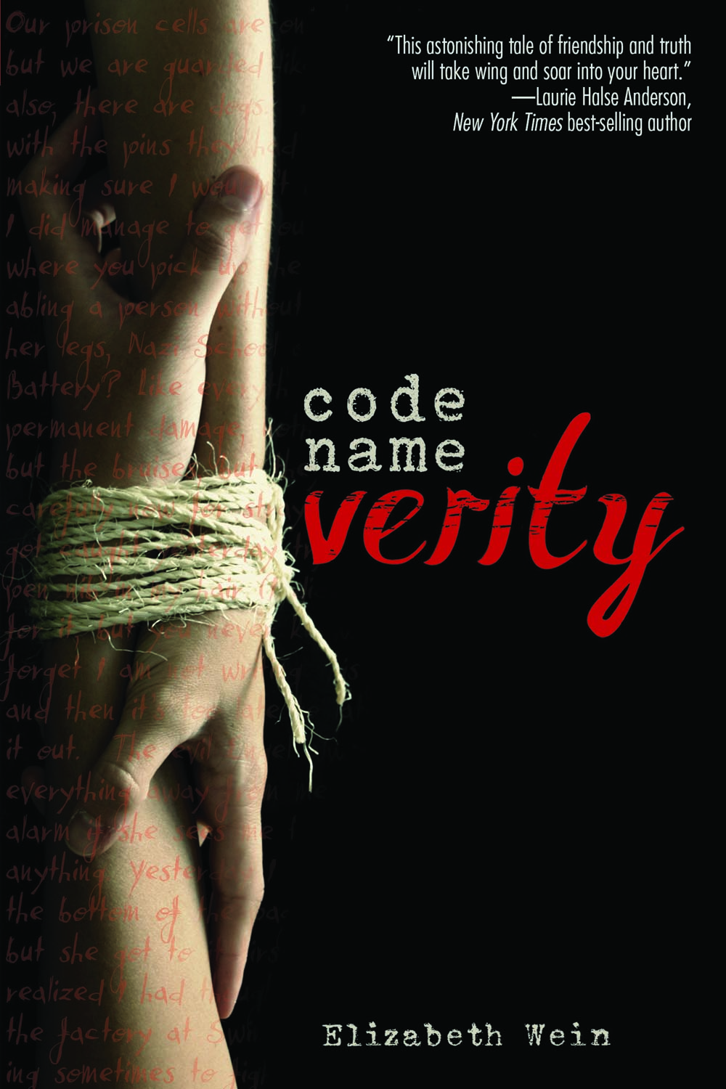
Code Name Verity
Even through a war, the connection shared by best friends is something special. After being caught behind enemy lines, Queenie attempts to distract her Nazi captors by recreating the story of her best friend Maddie. Unsure if Maddie made it through the crash that landed the two in trouble, Queenie weaves a gripping tale of intrigue, spies, and friendship in order to survive.
By Elizabeth Wein

Slide 3
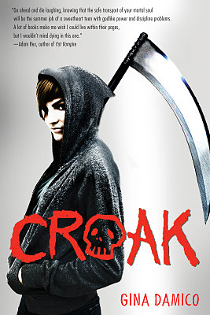
Croak
When 16-year-old Lex continues to act out at school, her parents decide to have her spend the summer with her Uncle Mort in the small town of Croak, thinking that fresh air and hard work will do her good. Life there isn’t what Lex expects: her uncle isn’t a farmer, but a Grim Reaper who thinks she is ready to learn the family trade. Ushering souls to the beyond is no easy task, but this tale gives a fun take on life, death, and what comes next.
By Gina Damico

Slide 4
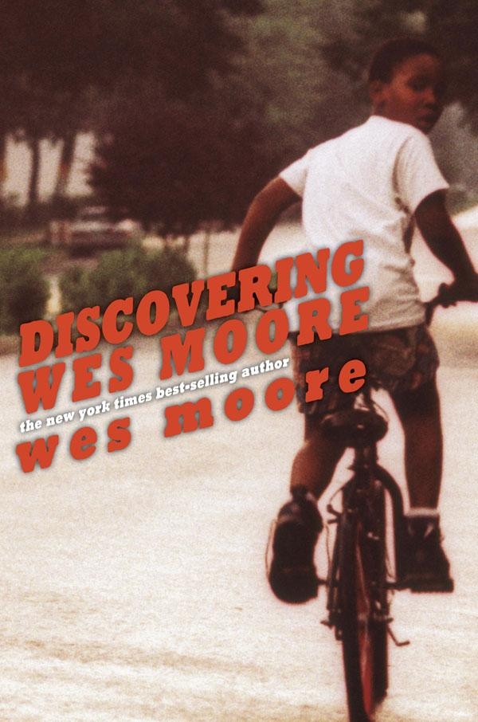
Discovering Wes Moore
How many people share the same name? What about two people who share the same name AND similar lives? What about life choices? Two African American men are both named Wes Moore. One personal choice made these two lives that started out so similar become very different.
By Wes Moore

Slide 5
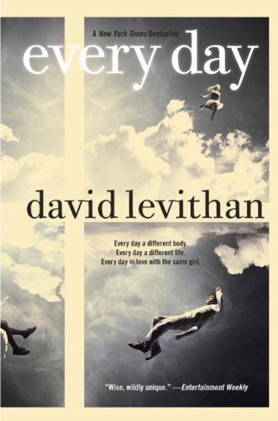
Every Day
Have you ever wondered what it would be like to live someone else’s life? A does just that, waking up every morning in a different person’s body. One day, A falls in love, but how can you get a person to love you back when they don’t even know who you are the next day?
By David Levithan

Slide 6
The Fault in Our Stars
Sixteen-year-old Hazel meets Augustus at her weekly cancer support meeting, and the two go on a journey through love, life, and death. John Green’s skill at writing about teens dealing with real life situations continues to shine. Be warned: you will need a box of tissues.
By John Green

Slide 7
I Hunt Killers (Jasper Dent, Book 1)
Jasper Dent, son of notorious serial killer Billy Dent, helps hunt a copycat killer while struggling with just what it means to be Billy’s son. Can Jazz’s experience as the son of a killer provide the clues the police need, or is he more like Dear Old Dad than even he knew?
By Barry Lyga

Slide 8
The Selection
Every girl dreams of being part of the Selection, the chance to marry Prince Maxon and live happily ever after. America Singer isn’t every girl though. She would be content to marry lower-class Aspen, but is she really willing to live a life of poverty for the guy she loves? Will she even get to make the choice? If she is chosen for the Selection, she must go to the palace and fight for the Prince whether she likes it or not.
By Kiera Cass

Slide 9
Seraphina
Sixteen-year-old Seraphina lives in a world of uncertainty as tensions between humans and dragons threaten to become a full-scale war. With the death of a leader, those tensions reach a climax, Seraphina must protect the secrets that lie at the very core of who she is and, hopefully, prevent the fiery destruction of the life she knows.
By Rachel Hartman

Slide 10
Something Like Normal
Soldier. Son. Survivor. Eighteen-year-old Travis returns home on leave from a tour in Afghanistan, and now must deal with an overprotective mother, a dismissive father, and an entitled younger brother. He yearns to return to the familiarity of Afghanistan, but first he must cope with the death of his best friend, a fellow soldier in his company.
By Trish Doller

Slide 11
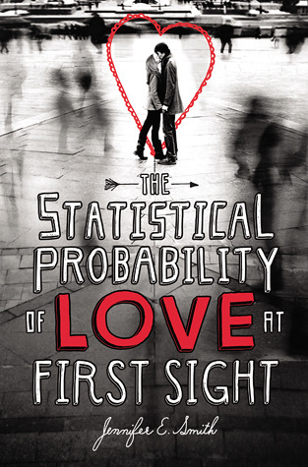
The Statistical Probability of Love at First Sight
Two seventeen-year-olds, Hadley, an American on her way to attend her father wedding, and Oliver, a Brit returning home, meet and fall in love on their flight from New York to London. Once they arrive, however, they are separated at the airport. Fate brought them together. Can it reunite them?
By Jennifer E. Smith

